Slide 1
PROJECT TITLE: BAGH-BONDI
PRESENTED BY-
NAME: HASIB ABDULLAH SARKER
EXAM ROLL: 60930
Gh
SUPERVISED BY-
DR. AHMEDUL KABIR
ASSISTANT PROFESSOR

Slide 2
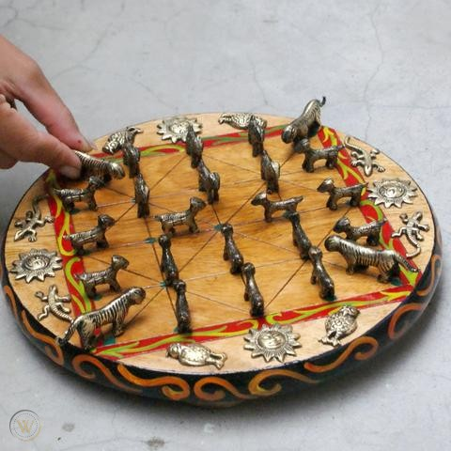
PROJECT DETAILS (BAGH-BONDI)
IT IS A STRATEGIC TWO PLAYER BOARD GAME THAT ORIGINATED IN NEPAL.
IN SOME PLACES IT IS ALSO KNOWN AS BAGH CHAL.
IN BANGLADESH, IT IS ALSO PLAYED IN RURAL AREA.
FIGURE: 1

Slide 3
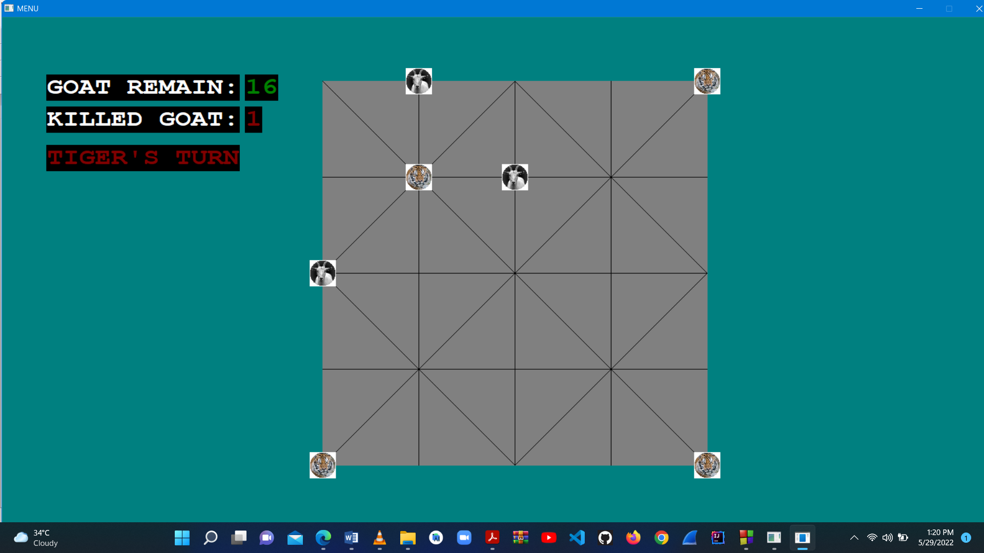
RULES OF THE GAME (BAGH-BONDI)
BOARD: THE GAME IS PLAYED ON A 5X5 POINT GRID
TWO -PLAYER CAN PLAY THIS GAME.
ONE WILL PLAY AS TIGER AND ANOTHER WILL AS GOAT.
AT THE BEGINNING, THE BOARD IS INITIALIZED WITH FOUR TIGERS AT THE FOUR CORNER OF THE BOARD
FIGURE: 2
ANOTHER PLAYER WILL GET TWENTY GOATS.

Slide 4
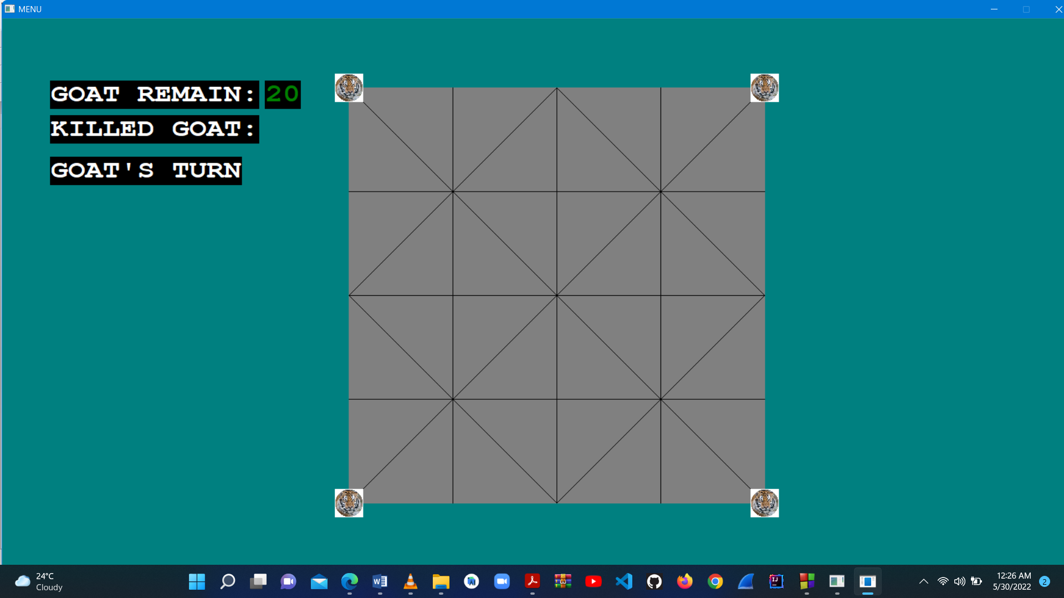
RULES OF THE GAME (BAGH-BONDI)
FIRST MOVE: THE PLAYER WHO CONTROLS THE GOAT WILL MAKE THE FIRST MOVER BY PLACING A GOAT ON THE BOARD
ONE PLAYER CAN MOVE EXACTLY ONE TIME IN HIS TURN.
FIGURE: 3

Slide 5
RULES OF THE GAME (BAGH-BONDI)
VALID MOVE CONDITIONS:
TIGER:
1.TIGER CAN MOVE FROM ONE POINT TO ANOTHER ( IF THE POINT IS EMPTY )
2. A TIGER CAN’T JUMP OVER ANOTHER TIGER.
3. A TIGER CAN JUMP OVER A GOAT, IF THERE IS AVAILABLE PLACE (THEN THE GOAT WILL
BE COUNT AS KILLED )

Slide 6
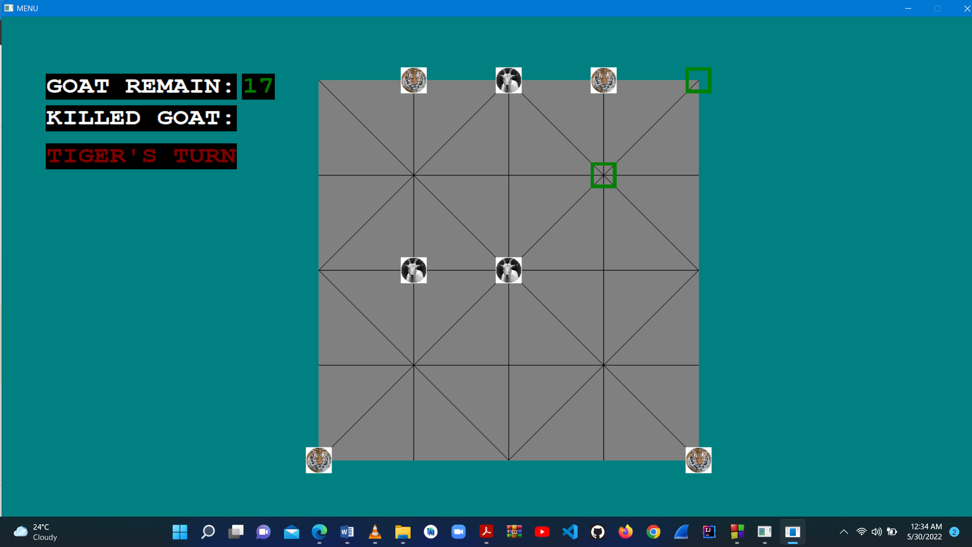
VALID MOVE CONDITIONS:
( TIGER )
THE VALID POSSIBLE MOVE FOR THE SELECTED TIGER
FIGURE: 4

Slide 7
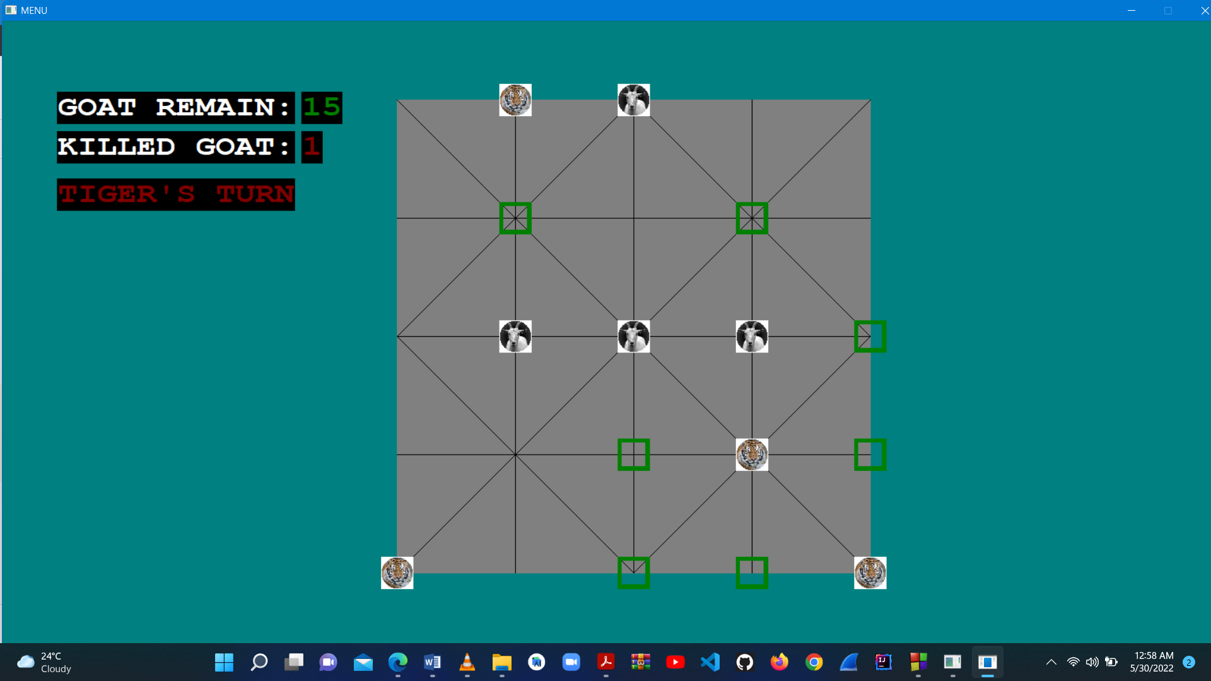
VALID MOVE CONDITIONS:
( TIGER’S KILL MOVE )
HERE ,IF THE SELECTED TIGER JUMP OVER THAT GOAT, THEN THE GOAT WILL BE COUNTED AS KILLED
FIGURE: 5

Slide 8
VALID MOVE CONDITIONS:
GOAT:
1. GOAT CAN MOVE FROM ONE POINT TO ANOTHER LIKE
TIGER (AFTER PLACING TWENTY GOATS ON THE BOARD)
SELECTED GOAT CAN’T MOVE BECAUSE 17 GOATS ARE REMAIN TO BE PLACED ON BOARD
FIGURE: 6

Slide 9
VALID MOVE CONDITIONS:
GOAT:
2. A GOAT CAN’T JUMP OVER A GOAT OR TIGER

Slide 10

RULES OF THE GAME (BAGH-BONDI)
WINNING CONDITIONS:
FOR THE PLAYER ( SELECT GOAT):
IF THE GOATS BLOCK THE FOUR TIGERS FROM
BEING ABLE TO MOVE, THEN THE HE/SHE WILL
WIN !!
HERE THE SELECTED TIGER IS ON TRAP
FIGURE: 7

Slide 11
FOR THE PLAYER ( SELECT TIGER):
WINNING CONDITIONS:
IF TIGERS KILLED FIVE GOATS , THEN THE PLAYER WILL WIN

Slide 12
PROJECT GOALS (BAGH-BONDI)
PROJECT GOALS:
TO DEVELOP A VIRTUAL PLATFORM TO PLAY THIS BOARD GAME.
USING EFFICIENT ALGORITHM OF C/C++
TWO MODE:
PLAYING WITH FRIENDS
PLAYING WITH COMPUTER
→PLAY AS GOAT
→PLAY AS TIGER

Slide 13
DEVELOPMENT STATUS(BAGH-BONDI)
MODE: PLAYING WITH FRIENDS
MODE: PLAY WITH COMPUTER
→ PLAY AS GOAT
→ PLAY AS TIGER
SUCCESSFULLY DONE THIS TWO MODE !!
READY FOR PLAYING……
USING CONSOLE—>>USING GRAPHICS

Slide 14
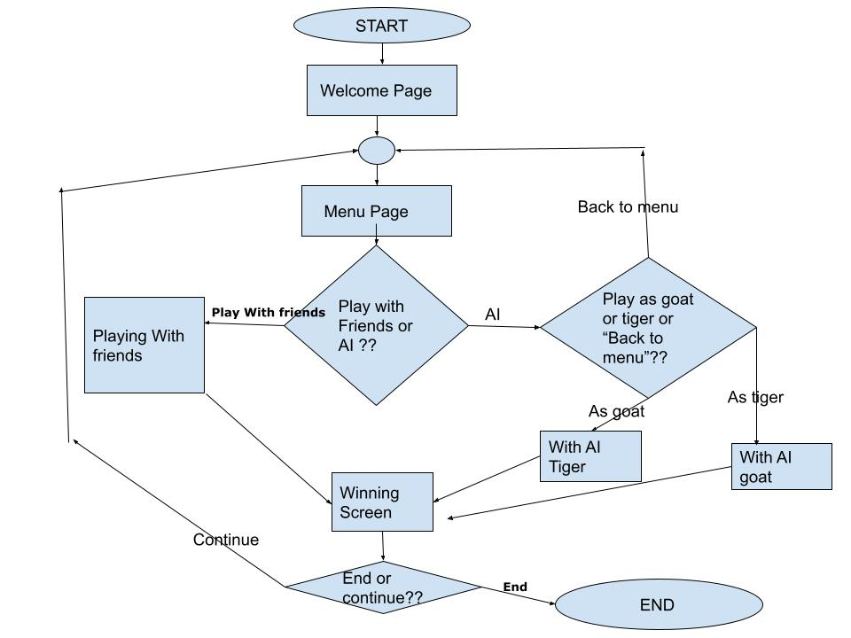
FLOW CHART OF THE WHOLE PROJECT

Slide 15
DEVELOPMENT DETAILS ( BAGH-BONDI )
MODE: PLAYING WITH COMPUTER AND FRIENDS
TOOLS AND ALGORITHM
LANGUAGE: C++
ALGORITHM: MINIMAX ALGORITHM IS USED WITH ALPHA BETA PRUNING FOR AI
IMPLEMENTATION
GRAPHICAL USER INTERFACE: A GRAPHICAL LIBRARY(HEADER FILE)
OF C++ NAMED “GRAPHICS.H”
PROJECT DEVELOPMENT ENVIRONMENT: VIRTUAL STUDIO CODE
VERSION CONTROL: GITHUB

Slide 16
DEVELOPMENT DETAILS ( BAGH-BONDI )
GRAPHICAL INTERFACE:
GRAPHICS.H —>
MOUSE CLICKED MOVEMENT FOR BOTH GOAT AND TIGERS
BOARD DRAWING

Slide 17
DEVELOPMENT DETAILS ( BAGH-BONDI )
FACED PROBLEM:
FIRST TIME FOR ME TO IMPLEMENT MY IDEA INTO A PROJECT
IMPLEMENTING MINIMAX FOR GOAT AS WELL AS FOR TIGER
HAD TO HANDLE TOO MANY LINES OF CODE (ALMOST 2000 LINES OF CODE )
MANY CALCULATIONS
TO MAKE GRAPHICAL INTERFACE
—>MOUSE CLICKED RESPONSE

Slide 18
DEVELOPMENT DETAILS ( BAGH-BONDI )
FUTURE SCOPE:
Since this software is implemented by keeping its broader aspects in mind, it can be expanded in future with extra features (Efficient AI , Different shape on board, different levels of AI).

Slide 19
DEVELOPMENT DETAILS ( BAGH-BONDI )
GITHUB REPOSITORY: https://github.com/hasib1224/BAGH-BONDI

Slide 20
THANK YOU

